Slide 1
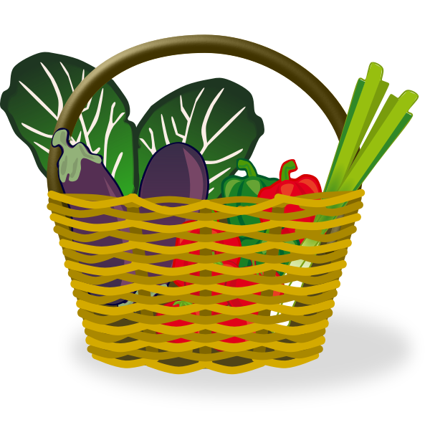
Food Saver
Jasmine, Morgan, Monet, Obehi, Sydney

Slide 2
Targeted Users
Description/ Purpose
The website allows registered food providers to register and sell their soon to expire food at a very low cost.
Sellers are able to register and create an account in order to add their products
Customers can place an order for their selected food items and schedule a pickup to receive their order
Users who want to be buy discounted grocery items.
Ex. college students, those from low-income households, etc.
Users who want to sell their almost expired grocery items at a low cost.
Ex. grocery stores (Walmart, Kroger, etc.)

Slide 3




Final Chosen Technical Platforms
UI
HTML
CSS
Bootstrap
Middle Layer
Java
Java Servlet
JDBC
Backend
MySQL
Others
Visual Studio Code
GitHub
Notes:
Java Servlet
Obtains the information from the user
Handles requests obtained from the web server, processes the requests, produces a response, and sends a response back to the webserver
JDBC
Connects to the database based on the data provided by the servlet
MySQL
Holds all the data of the website (related to users, product information, etc)

Slide 4
UML SEQUENCE DIAGRAM
UML Sequence Diagram
Backup Link: PDF

Slide 5
USER CASE UML DIAGRAM (1)
UML Use Case Diagrams
Backup Link: PDF

Slide 6
USER CASE UML DIAGRAM (2)
UML Use Case Diagrams
Backup Link: PDF

Slide 7
PROCESS FLOW
Process flow in Mural

Slide 8
HTML DEMO

